Slide 1

The Death of Stalin
Group 5
Sahil Aggarwal Aditya Chatterjee Kevin McCraney
Altan Orhon Umang Sehgal
Cinemetric data in 20th century Russian films

Slide 2
Agenda
Primer of important concepts
Research question
Methods
Preliminary analysis
Results
Concluding remarks

Slide 3
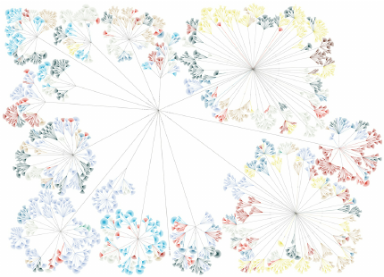
Digital humanities
The digital humanities is an emerging research field.
It is the intersection of traditional liberal arts (literary studies, film studies, etc.), statistical methodology, and computer technology.
One of the focuses is trying to understand large-scale cultural change through a society’s art (like paintings, poems, books, or films).
NLP and network analysis (and other stuff we might do in 574!) are common techniques.
Notes:
https://www.researchgate.net/figure/Distant-reading-example-shows-the-structure-of-and-the-themes-in-Jack-Kerouacs-On-the-Ro_fig2_282156818

Slide 4
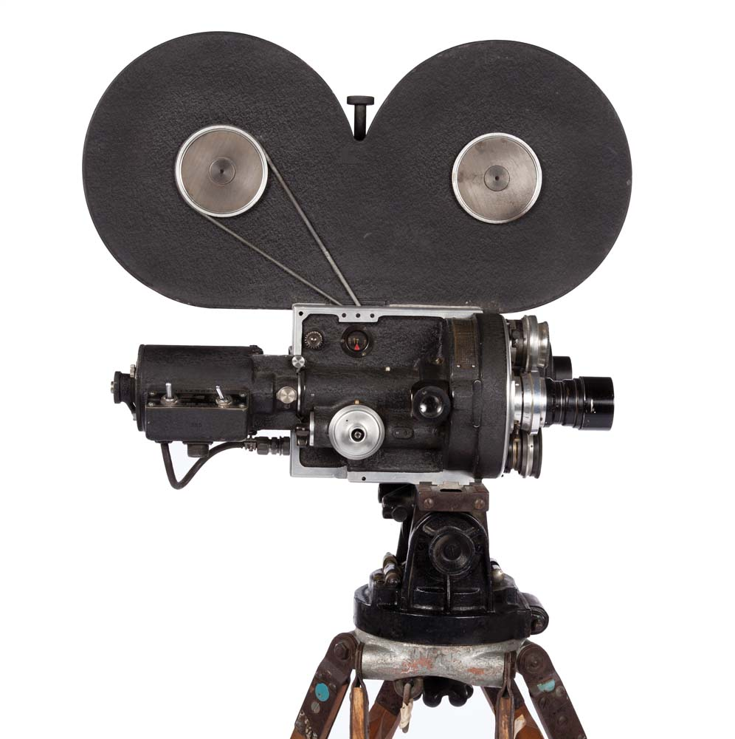
Film theory primer
Cinema is one of the first global art forms.
Russian directors (like Eisenstein) contributed quite a bit to film technique.
Montage (cutting scenes together) is the grammar of cinema.
Changes induced in a film through montage are called dynamics.
Dynamics help build feelings for viewers of a film (tension vs. calm, for example).
Notes:
Going to use russian interchangeably with soviet, russian, and USSR throughout.

Slide 5

Let’s go to the tape!
Let’s contrast two dramatically different films to understand montage:
October: Ten Days that Shook the World (1927), dir Sergei Eisenstein
Solaris (1972), dir Andrei Tarkovsky
Did you notice the contrast in shot duration or the number of shots?

Slide 6

Historical primer
After the Russian Revolution (1917), a new regime needed to consolidate power.
People were distributed across a huge country, and were mostly illiterate.
Lenin (and Stalin) used art as a political tool, but especially visual art (like film).
Stalin mandated a policy of socialist realism, starting in 1933.
The goal was to champion the real life of workers, the average citizens.
To show real life effectively, we surmise directors would use less montage.

Slide 7
Our research question
Is there a statistically significant and substantial change in film dynamics in the Soviet Union after 1934 (after mandated socialist realism) and then again in 1953 (after Stalin’s death)?

Slide 8

Methods: Our data source & features
Cinemetrics, a movie measurement database, was our primary source.
Contains both qualitative features (film name, director, country) and quantitative features (shot length, number of shots per film, median/average shot length per film, and so on).
Total Films: ~18,000
Notes:
Cinemetrics is our source. It’s a movie measurement database containing several thousand entries of films from around the world.
Discuss cleaning it
Discuss how we constrained our research question
Describe the features

Slide 9
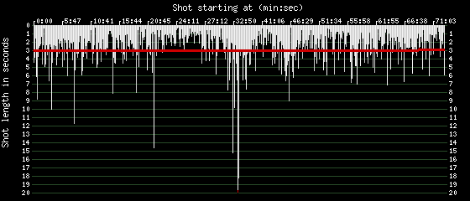
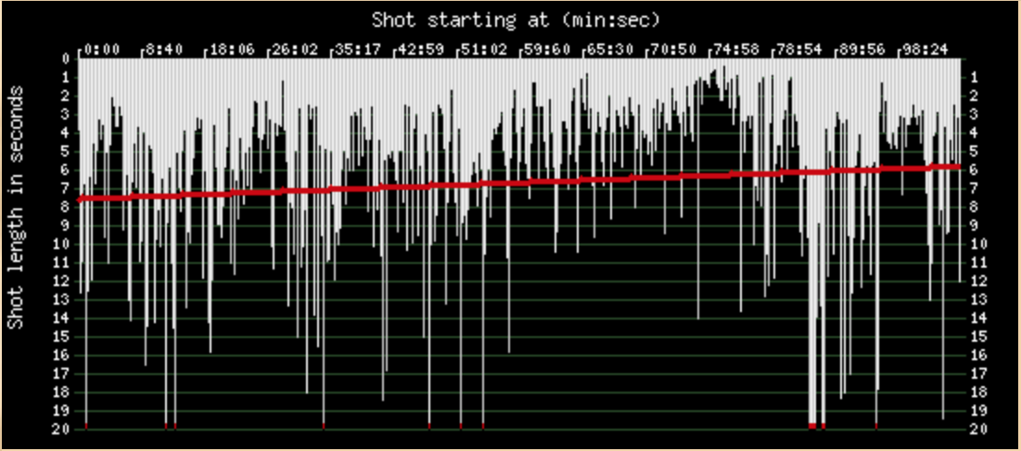
Methods: Our data source & features
This is how Cinemetrics data is visualized on the site:
Battleship Potemkin (1925)
Alexander Nevsky (1938)
Shots in min:sec plotted against shot length, with regression lines.

Slide 10
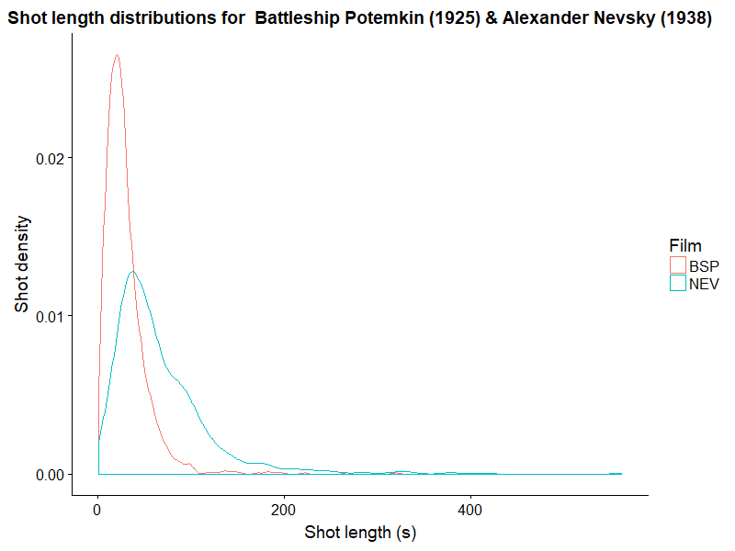
Example: Shot length distribution of 2 films

Slide 11
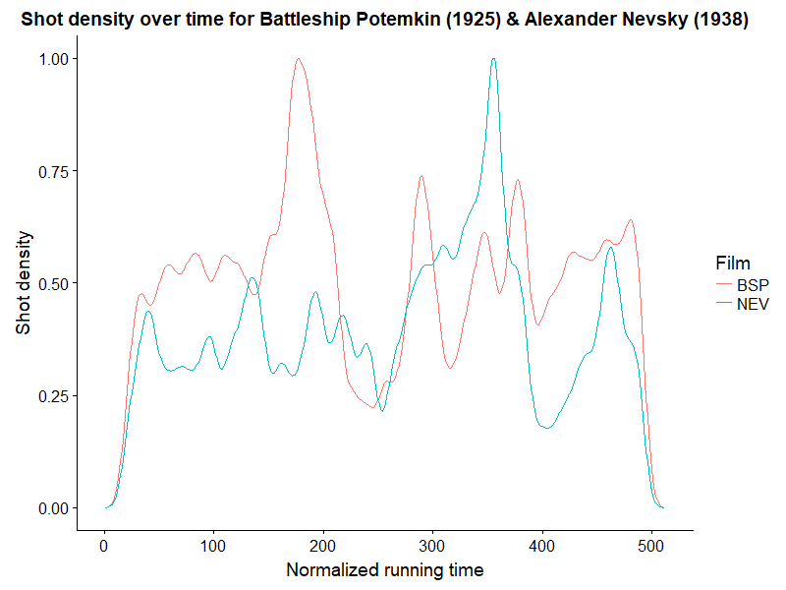
Example: Shot density over time of 2 films
Notes:
We did this by standardizing films to the scale we see here, in order to effectively gauge shot density.

Slide 12
Methods: Our data source & features
There was no API, so we scraped the HTML into a database.
We found films where Russia, USSR, or Soviet Union was listed as country of origin. These comprised our secondary dataset.
We output the data as a CSV containing just these films.
Total Films: 243

Slide 13

Tweaking the approach
After grabbing data, we realized we had to control for sound.
Sound became prevalent in the late 1920’s & early 1930’s.
It afforded directors new cinematic techniques: visual was not the only channel for storytelling.
Continuity would be carried by the audio track as well.

Slide 14
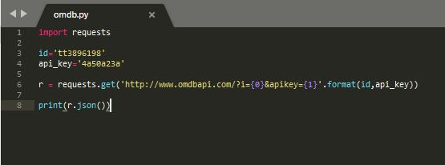
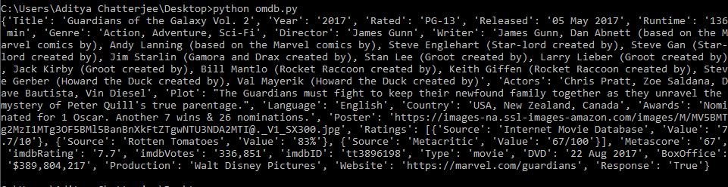
Retrieving missing data using the OMDb API
Among other things, Cinemetrics lacks information about genre, language and popularity.
We treated OMDB as a single source of truth for this information.
OMDb provides a RESTful API for film metadata. IMDb IDs from the Cinemetrics dataset were used to retrieve JSON metadata, which we appended to our dataset.
We made a categorical classifier [Sound: 1; NoSound: 0].

Slide 15
Methods: Our data source & features
We deduplicated similar titles, removed films shorter than 40min (less than feature film length), and compared lengths to OMDB to ensure we were dealing with the right movie.
Total Films: 132
Notes:
Cinemetrics is our source. It’s a movie measurement database containing several thousand entries of films from around the world.
Discuss cleaning it
Discuss how we constrained our research question
Describe the features

Slide 16
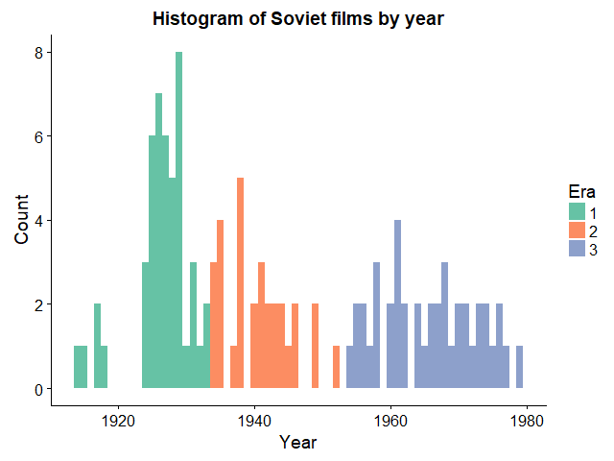
Preliminary Analyses
Year of Distribution
Era 1 - Released before 1934 (before legally mandated socialist realism)
Era 2 - Released from 1934 to 1953 (until the end of the Stalin era, after which policies were relaxed)
Era 3 - Released after 1953
Notes:
Kevin spoke about dynamics of movies, and so we took each feature Aditya talked about and saw how they contributes to these dynamics and sort of saw how they faired across the three different eras as part of the exploratory data analysis.

Slide 17
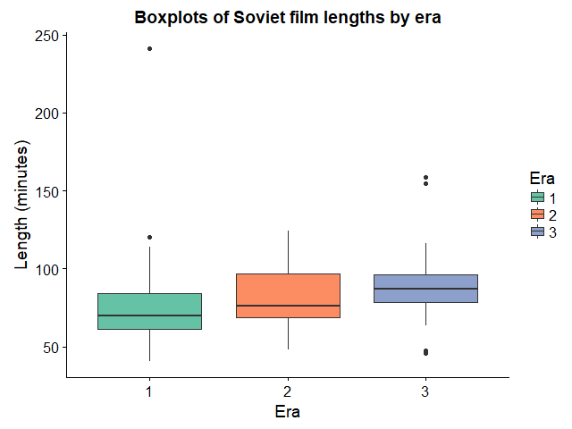
Preliminary Analyses
Length of film by Era
The length of films increased after mandated socialist realism but were largely consistent post Stalin’s death.

Slide 18
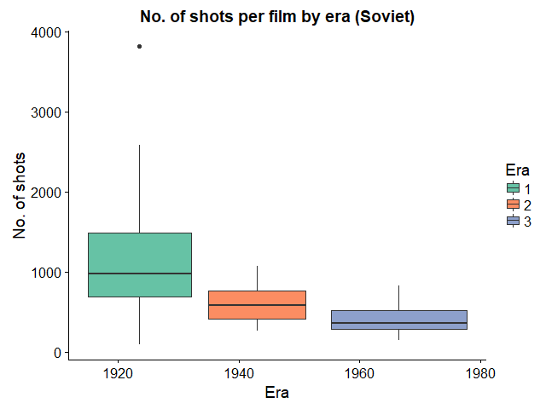
Preliminary Analyses
Number of Shots per film by Era
The number of shots fell drastically as seen from the trend across the three eras.
Notes:
‘Number of shots by Era’ is one of the most interesting trends we noticed. As you saw in the videos contrasting two directors belonging to two different eras.

Slide 19
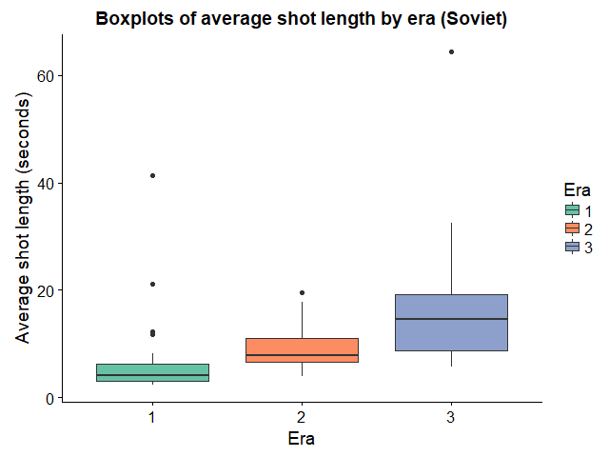
Preliminary Analyses
Average Shot Length by Era
Average of shot lengths tended to significantly increase over time across the three eras.
Notes:
But we thought average is not a good measure because of the outliers (which in some case are quite dramatic). It's not normally distributed, so we went on to observe trends in median shot length

Slide 20
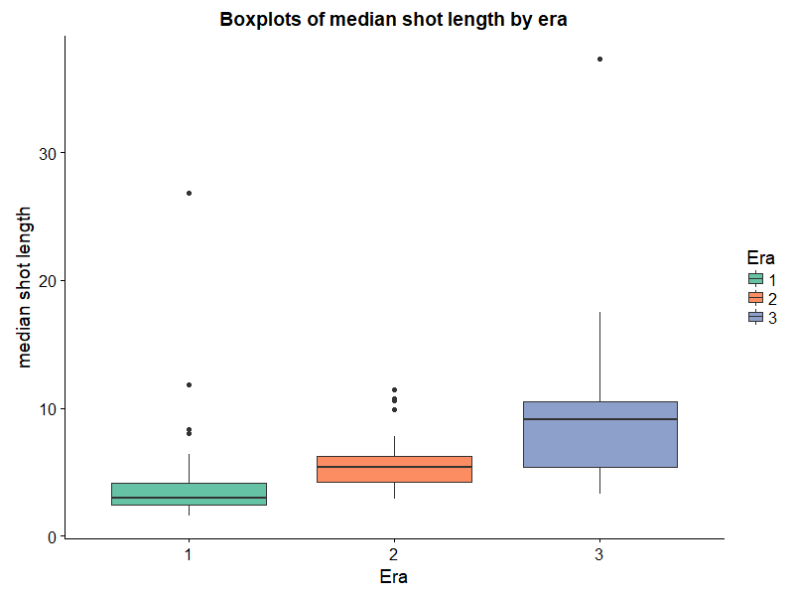
Preliminary Analyses
Median Shot Length by Era
Shot lengths tended to increase over time across the three eras. Slightly between eras 1&2, and significantly between 2&3.

Slide 21
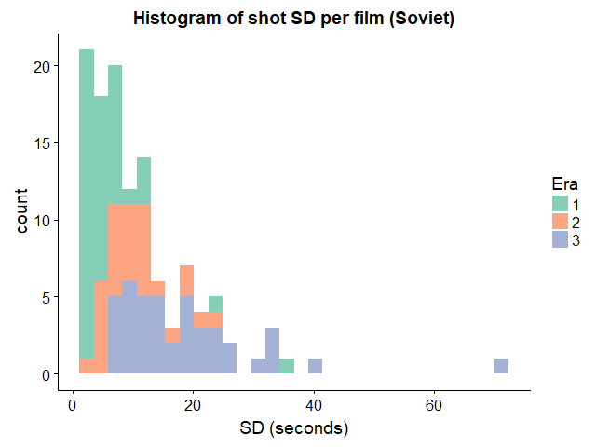
Preliminary Analyses
Shot Length Standard Deviation by Era
A low standard deviation suggested that the films are closely similar to each other across the three eras. The values are positively skewed.

Slide 22
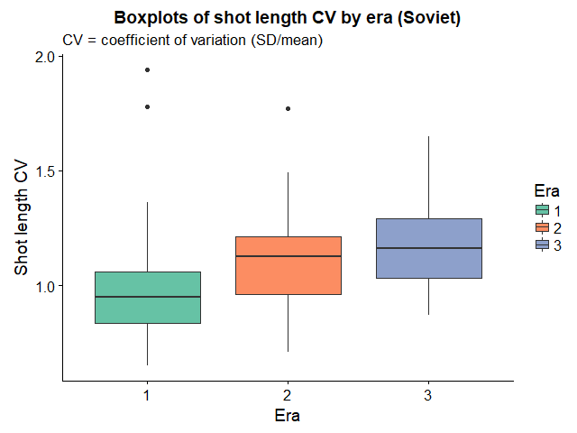
Preliminary Analyses
Shot Length Coefficient of Variation by Era
The coefficient of variation increased every era, significantly after introduction of mandated socialist realism and went on to slightly increase after Stalin’s death.

Slide 23
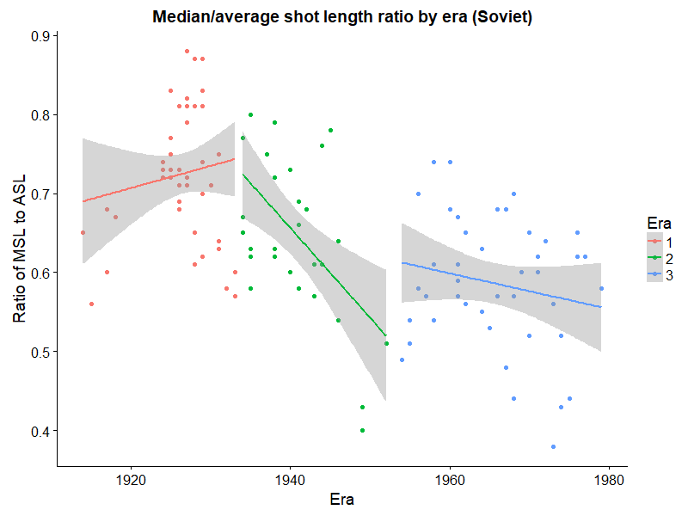
Preliminary Analyses
Ratio of Median Shot Length to Average Shot Length
During the time period predicted, the ratio between mean and median shot length went down, and then went back up after Stalin’s death. Cinemetrics’ authors included this as a measure of skewness.

Slide 24
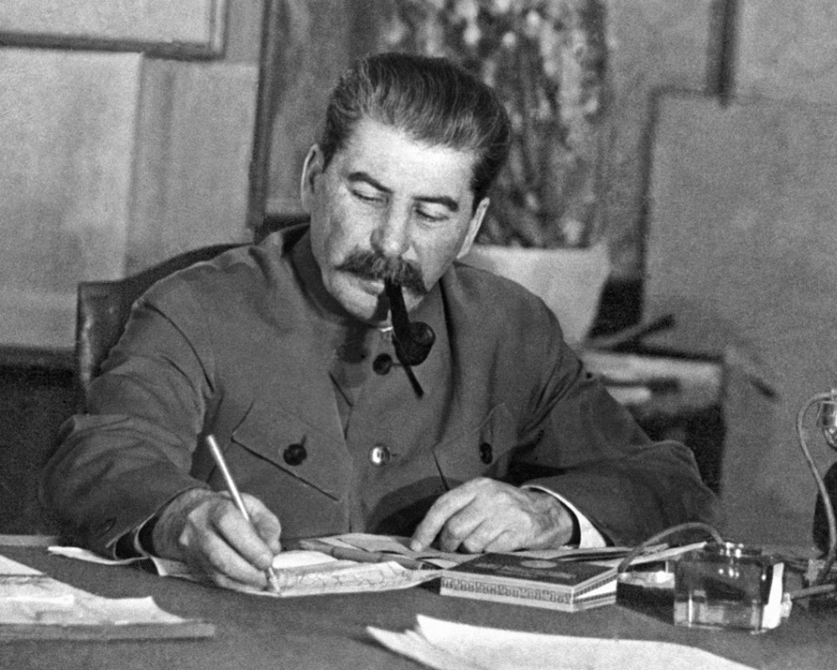
Hypothesis
H₀: There is no statistically significant change in the dynamics (length & variability of shots) of Russian film corresponding to the enforcement of Socialist Realism in 1934 and Stalin’s death in 1953.
H₁: There is a statistically significant change in the dynamics (length & variability of shots) of Russian film corresponding to the enforcement of Socialist Realism in 1934 and Stalin’s death in 1953.

Slide 25

Testing
We built linear models to study how film dynamics including median shot length, Q_{n}, and Q_{n} / median shot length change by era.
Q_{n}is a robust estimator of scale that is more efficient than median absolute deviation. We used this, and its analogue to coefficient of variation, instead of standard deviation and coefficient of variation in order to make the analysis more robust.
As a covariate, we considered the absence/presence of sound in the film, as it had an impact on how films were shot.

Slide 26
Linear model assumptions & transformation
We ran diagnostics to check for outliers, heteroskedasticity, autocorrelation, nonnormality of residuals, and multicollinerarity. Before log transformation, normality of residuals was violated in every case per the Shapiro-Wilk test of normality. Once the data were log-transformed, all tests were passed successfully. Log transformation for analysis is consistent with the literature in this field, as almost all of the variables have a log-normal distribution.
Notes:
Omega-squared is within the same dimensions as r-squared, so we can use the same sort of heuristic as r-squared to account for variance.
If we didn't log-transform the data, it would have violated the assumptions of the test of normality, and we wouldn’t be able to use it for regression.

Slide 27
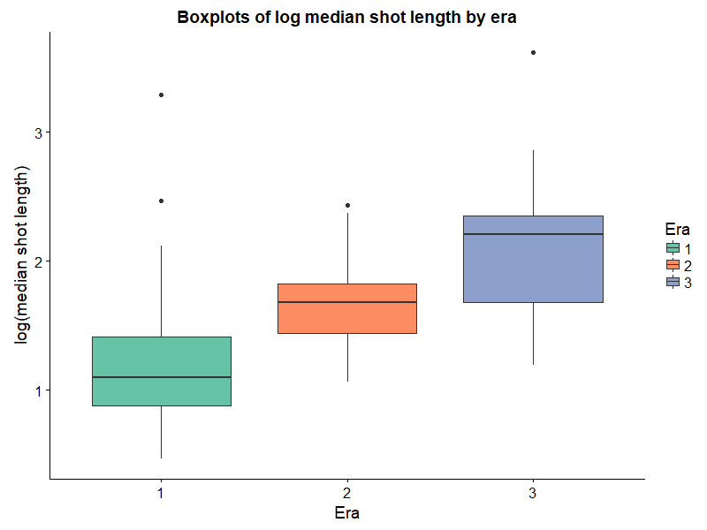
Log of median shot length
Notes:
Omega-squared is within the same dimensions as r-squared, so we can use the same sort of heuristic as r-squared to account for variance.
If we didn't log-transform the data, it would have violated the assumptions of the test of normality, and we wouldn’t be able to use it for regression.

Slide 28
ANCOVA - Log of median shot length
ANCOVA: log(median shot length) ~ Era + HasSound
Main effect of Era = F(2, 115) = 29.7 , p < .001, ω² = .141. LARGE EFFECT
Main effect of Sound = F(1, 115) < .001 , p = .999.
Planned comparisons (treatment contrasts compared to Era 2):
Difference between era 1 and 2 is significant (difference = -.48, , p < .001)
Difference between 3 and 2 is significant (difference = .39, p = .002).
Interpretation: median shot length increased every era, supports our hypothesis
Effect size interpretation for ω² (analogous to R²): Small >= .01, medium >= .06, large >= .14 (Field, Miles, and Field, 2012)
Notes:
For ANCOVA, for F stat, the formula is something like total rows - total categories - 1

Slide 29
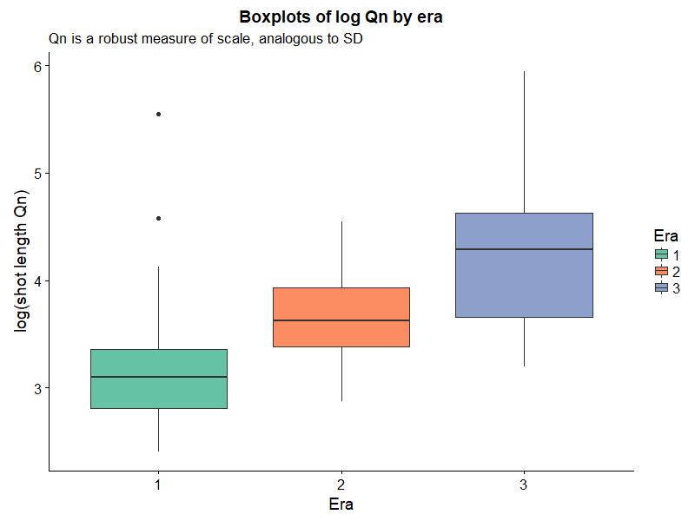
Log of Q_{n}
Notes:
Omega-squared is within the same dimensions as r-squared, so we can use the same sort of heuristic as r-squared to account for variance.
If we didn't log-transform the data, it would have violated the assumptions of the test of normality, and we wouldn’t be able to use it for regression.

Slide 30
ANCOVA - Log of Q_{n}
ANCOVA: log(Q_{n}) ~ Era + HasSound
Main effect of Era = F(2, 115) = 33.1 , p < .001, ω² = .06. MEDIUM EFFECT
Main effect of Sound = F(1, 115) = .014, p = .906.
Planned comparisons (treatment contrasts compared to Era 2):
Difference between era 1 and 2 is significant (difference = -.51, p < .001);
Difference between 3 and 2 is significant (difference = .52, p = .002).
Interpretation: variability of shot length increased every era, does not support our hypothesis
Effect size interpretation for ω² (analogous to R²): Small >= .01, medium >= .06, large >= .14 (Field, Miles, and Field, 2012)

Slide 31
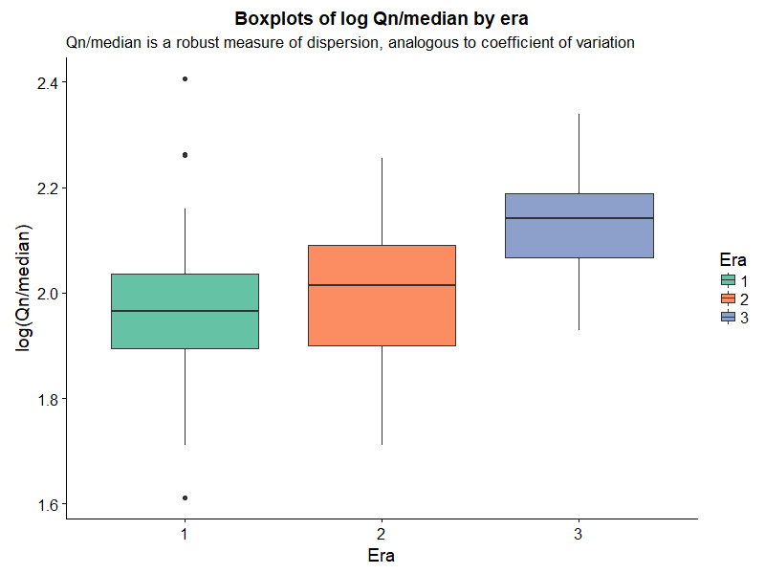
Log of (Q_{n}/median shot length)
Notes:
Omega-squared is within the same dimensions as r-squared, so we can use the same sort of heuristic as r-squared to account for variance.
If we didn't log-transform the data, it would have violated the assumptions of the test of normality, and we wouldn’t be able to use it for regression.

Slide 32
ANCOVA - Log of (Q_{n}/median shot length)
ANCOVA: log(Q_{n}/median shot length) ~ Era + HasSound
Main effect of Era = F(2, 115) = 14..4 , p < .001, ω² = .006. INSUBSTANTIAL EFFECT
Main effect of Sound = F(1, 115) = .239 , p = .626.
Planned comparisons (treatment contrasts compared to Era 2):
Difference between era 1 and 2 is not significant (p = .4);
Difference between 3 and 2 is significant (difference = .13, p = .002).
Interpretation: relative variability increased after Stalin era but was otherwise the same, does not support our hypothesis
Effect size interpretation for ω² (analogous to R²): Small >= .01, medium >= .06, large >= .14 (Field, Miles, and Field, 2012)

Slide 33
Experimentation
Tried using wavelets on shot-scale data per movie as input to various classifiers (svm, lda, rf, etc.); barely better than chance (.47-.62 accuracy)
Interrupted time-series analysis is in progress
Attempted nested model to consider movies globally and see if the Stalin era in film in the Soviet Union substantially differed from a global trend; results were difficult to analyze
May try a time-series comparison via Granger causality as another way of comparing to the global trend

Slide 34
Discussion
Partial support for our hypotheses.
Does variability in shot length really capture artistic experimentation?
Sound covariation is based only within movies of the Soviet Union, not globally.

Slide 35

Limitations
Our analyses are performed on summary statistics, not shot-level data
Handling duplicates & length
Subjective, crowdsourced measurements (from people with minimal statistical literacy)
Database limited by convenience/interest
Cinemetrics is (weirdly) not open about code or data
Meta-question: how do we account for new cinematic techniques?
Notes:
We picked movies based on a small set of criteria

Slide 36
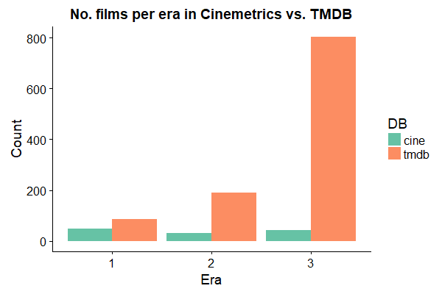
Limitations
Notes:
We picked movies based on a small set of criteria

Slide 37
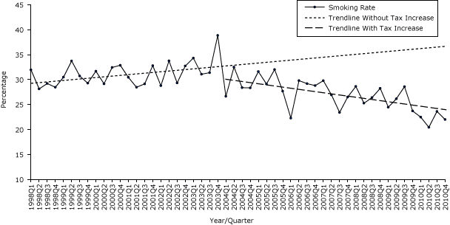
Further research: Interrupted time series
Widely used in the social sciences to study the effect of an intervention on the population being studied using longitudinal data.
The graph shows the projected trend line (smoking rate) based on past data if an intervention (increased taxes on tobacco products) had not occurred versus the trend line after the intervention has occurred.
We’d like to employ this method to study the impact on film dynamics before, during, and after the Stalin era.

Slide 38

Further work
Successfully compare global trends to the Russian trends (it crashed our computers).
Build a classifier to predict the time period of a film from shot data.
Account for short films.

Slide 39
Conclusion
We found partial support for our hypothesis (awesome)
We had some problems with our data source (typical!)

Slide 40
до свидания!
вопросов?
Notes:
Doh-sidan-ye - Goodbye!
VoPROsov - questions?

Slide 41
References
Baxter, M. (2014). Notes on cinemetric data analysis [monograph]. Retrieved from http://www.cinemetrics.lv/articles.php
Cinemetrics. (n.d.). Retrieved from http://www.cinemetrics.lv/database.php
Field, A. P., Miles, J., & Field, Z. (2012). Discovering statistics using R. London: Sage.

